Slide 1
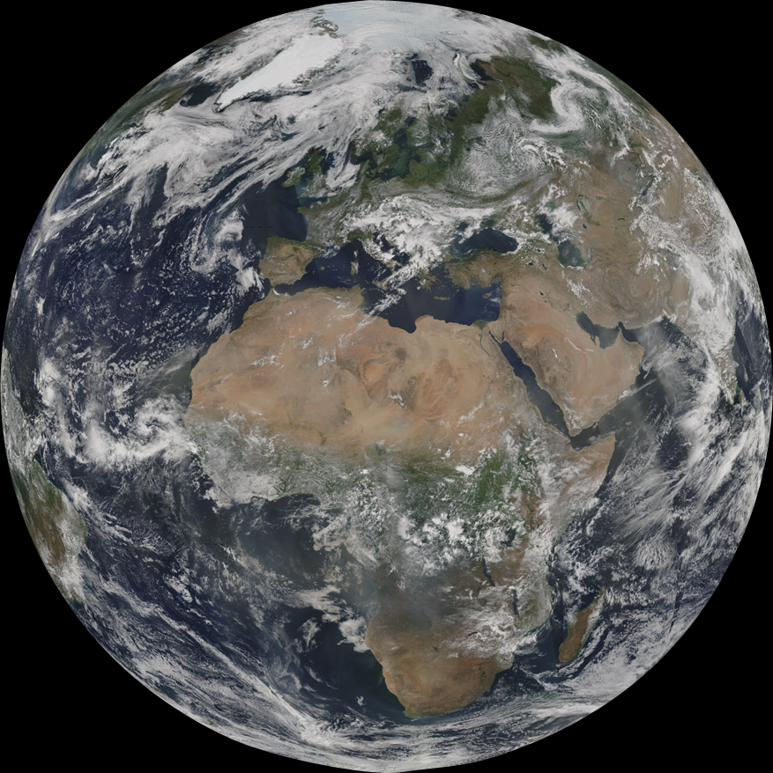
Ten Years of Cloud Optical/Microphysical Measurements from MODIS
M. D. King¹, S. Platnick², and the entire MOD06 Team
¹Laboratory for Atmospheric and Space Physics
University of Colorado-Boulder, USA
²NASA GSFC, Greenbelt MD, USA
IGARSS Cape Town
MODIS@10 – Session I
16 July 2009

Slide 2
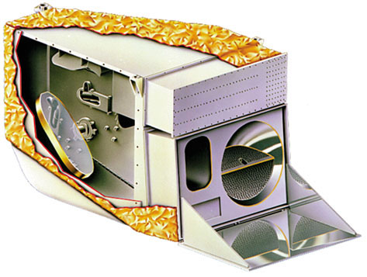
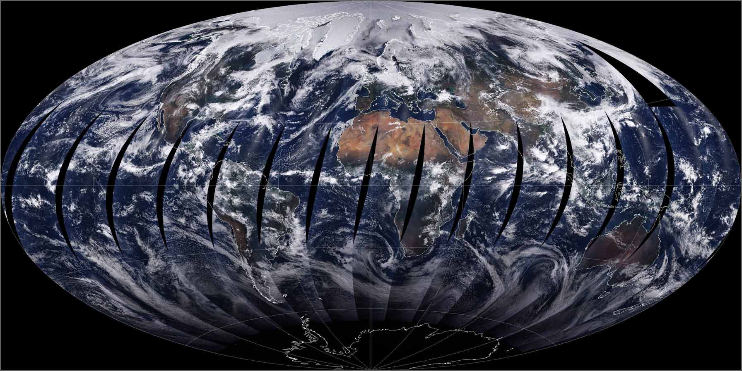
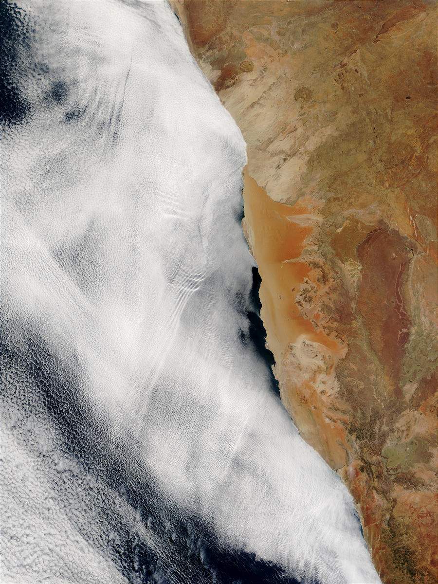
NAMIBIA
Outline:
Historical perspective
Overview of MODIS cloud optical products and capabilities
thermodynamic phase, optical thickness, effective particle radius, water path, baseline retrieval uncertainties
Algorithm Challenges: Level-2 and cloud property statistics (Level-3) examples
Notes:
Historical: hard to appreciate where you are, if you don’t know where you came from

Slide 3
Cloud Optical Remote Sensing: A Perspective
The way we were (AVHRR, circa early 1990’s) …
spectral capability: 5 channels, relatively broad (e.g., ~300 nm for NIR), single channel for cloud microphysics at 3.7 µm (or 1.6 µm starting w/NOAA-15 in 1998)
spatial resolution: GAC (~ 4x1 km, sampled every 4 scan lines), limited LAC/HRPT (~ 1km)
solar reflectance calibration: not stable or tracked on board
orbit control: none (NOAA-11 example: ~1340–1700 LT in 6 yrs)
data availability: 9-track tape postal orders, ~$70/tape (?)
MODIS …
spectral capability: complete set of channels for cloud microphysics (1.6, 2.1, 3.7 µm), cloud-top and cirrus optical/microphysics (8.5, 11, 12 µm, 13 µm CO₂ bands), thin cirrus detection (1.38 µm), H₂O bands
spatial resolution: 250–1000 m contiguous pixels
solar reflectance calibration: Solar diffuser, SDSM, SRCA
orbit control: Aqua example, ~ ±1 min control proposed starting in 2010
data availability: DAAC (online ordering/distribution), LAADS (online ftp)
Notes:
Circa early 90s: to really appreciate the EOS vision, you need to consider where we were as a community when EOS program was being formulated – what the reference bar was so to speak
3.7: original envisioned for cloud contamination for SST
HRPT (DB), LAC (local high-res. on board recording)
9-track: at least that was the status when EOS data systems were being formulated
Aqua control: ±15min, but much tighter over the mission
daily coverage for both

Slide 4
Summary of MODIS Cloud Products
Pixel-level (Level-2) products
Cloud mask for distinguishing clear sky from clouds
Cloud macrophysical, microphysical, and radiative properties
Cloud-top pressure, temperature, effective emissivity
Cloud optical thickness, effective radius, thermodynamic phase
Thin cirrus reflectance in the visible
Gridded time-averaged (Level-3), single atmosphere team product
Daily, Eight-day, Monthly
1° × 1° equal angle grid
Statistics: scalar (mean, standard deviation, …), 1D and 2D probability distributions
Steve
Ackerman:
next talk!
Notes:
2D for correlation studies

Slide 5
Cloud Optical & Microphysical Retrieval Challenges
MODIS Collection 5 MOD06/MYD06 Retrieval Algorithm
To retrieve or not to retrieve? Cloud Mask + “Clear Sky Restoral” algorithm implemented after cloud mask. Include cloud edge removal and 250m masking over the ocean.
Cloud thermodynamic phase: liquid water or ice libraries? MODIS SWIR bands have some information as does the IR – but continues to be a difficult problem (incomplete spectral coverage in SWIR)!
Ice cloud models: Realistic ice particle scattering calculations (Ping Yang) and cloud models (Baum, A. Heymsfield, et al.).
Surface spectral albedo: MODIS-derived (MOD43B, C. Schaff et al.) global snow-free land surface and snow/ice spectral albedo maps.
Retrieval uncertainty: Pixel-level τ, r_{e}, water path retrieval uncertainties from 3 fundamental error sources & estimates for uncertainty in L3 means.
Multilayer/multiphase scenes: Multilayer cloud flag, w/separate aggregation in L3 (0.94 µm + CO₂ bands).
Notes:
Better understand our capabilities - a reasonable understanding of our strengths and weaknesses.
A 23 p. document, with example imagery, is available on-line - but here are the highlights:
Two of these items are most relevant for this talk …
CSR: not cloud = dust, heavy smoke, snow, sun glint. You’ll see in an example that we don’t have much to do.
Some cloud retrievals considered basic and fundamental are ill-defined: What is a cloud mask? What is a cloud (depends on the part of the spectrum, among other things)? Cloud phase?
ML flag with aggregation to L3
Now let me show some Level-2 example, roughly in this order

Slide 6
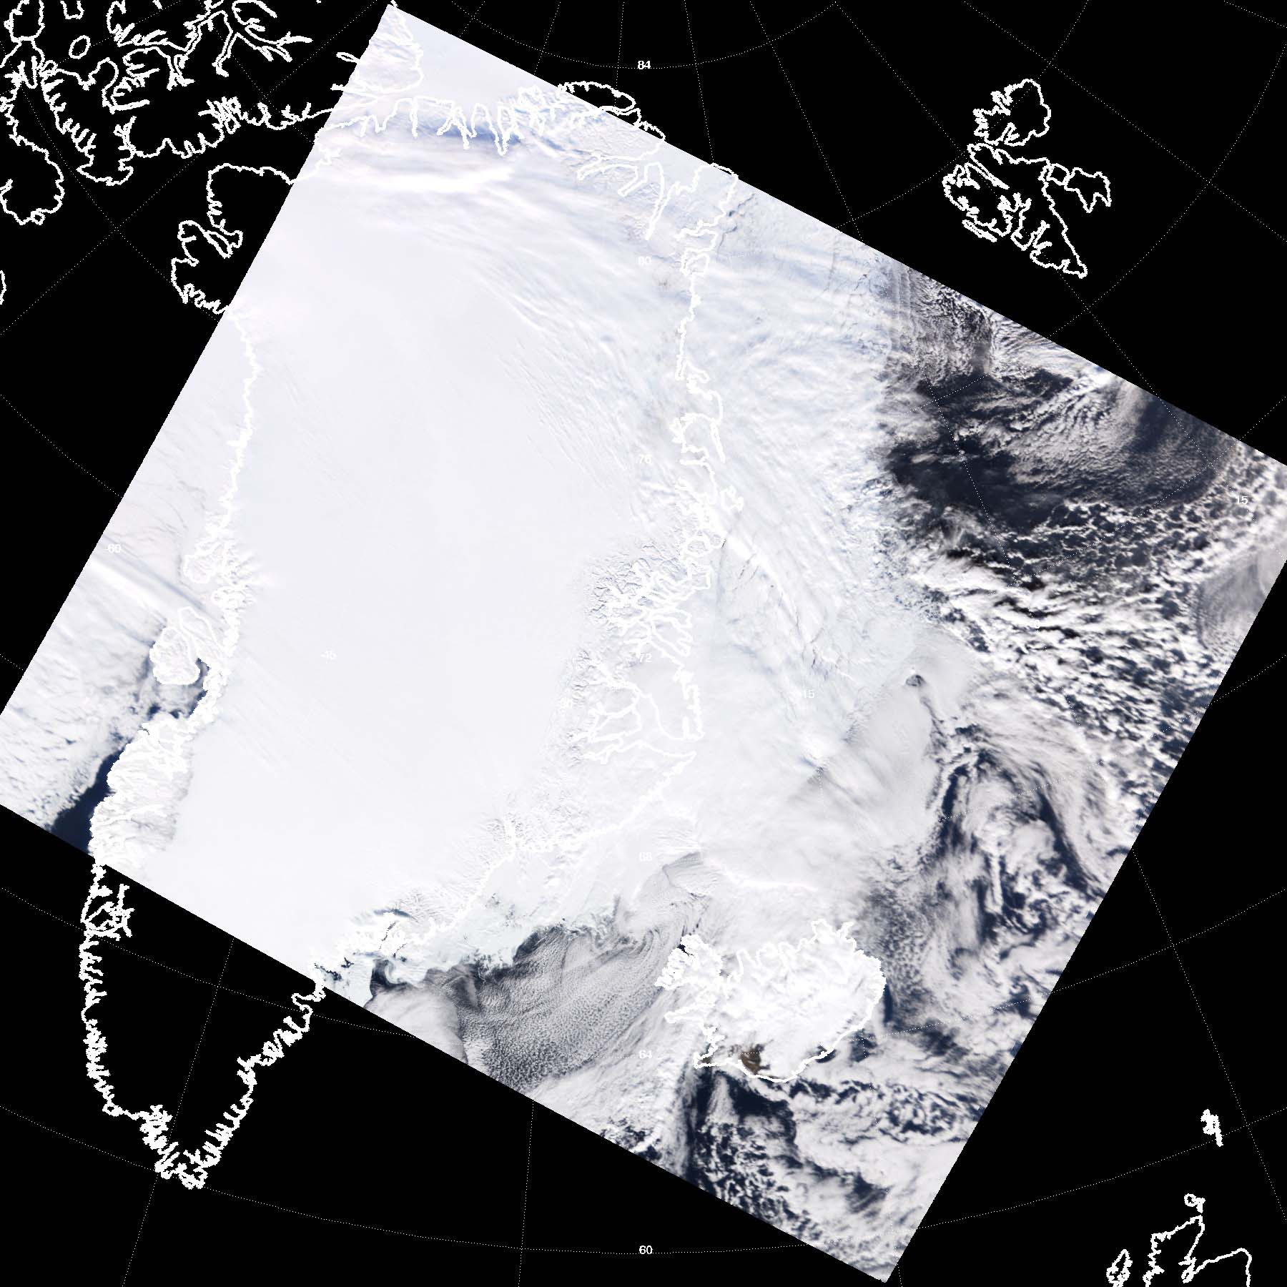
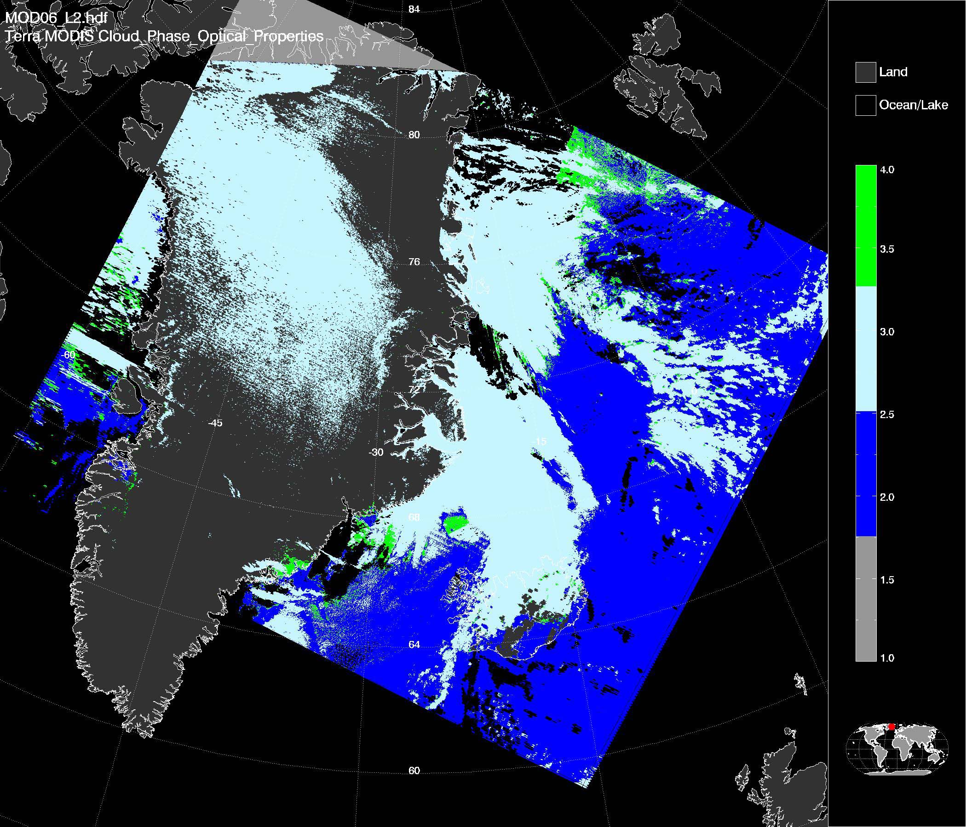
MODIS Cloud Thermodynamic Phase Example Algorithm: combination of VIS/SWIR, IR spectral tests
True Color Composite (0.65, 0.56, 0.47)
Thermodynamic Phase
MODIS Terra, March 22, 2001
Clear Sky
Liquid water
Ice
Uncertain
Collection 5 processing
Notes:
Working to establish validation vs. CALIPSO

Slide 7
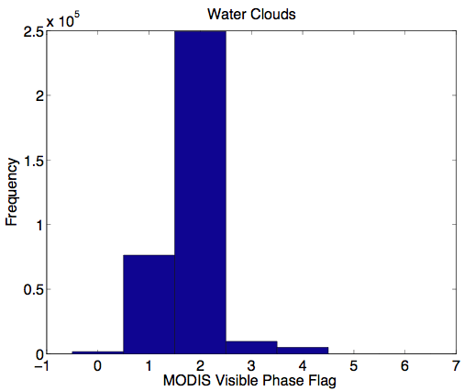
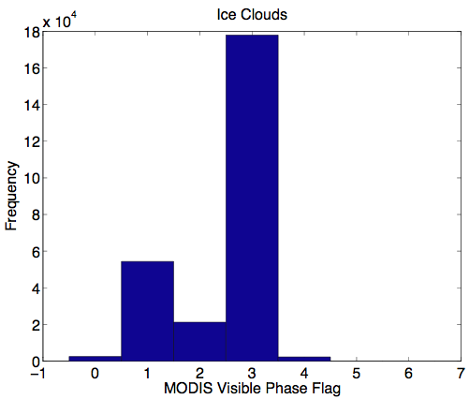
Example MYD06 Retrieval Phase vs. CALIPSO*
* Bob Holz et al. (not the CALIPSO phase product)
CALIPSO “single layer” co-locations, August 2006, ±60° latitude
CALPSO-derived liquid clouds
CALPSO-derived ice clouds
liquid
ice
no
retrieval
no
retrieval
liquid
ice
undetermined
undetermined
Cloud_Phase_Optical_Properties flag
Cloud_Phase_Optical_Properties flag
incorrect phase
Notes:
Mention: C-C grant with Steve Ackerman and Bob Holz …
The results of these pixel-level comparisons are very sensitive to how the data is filtered, and Bob and I have gone back and forth in trying to find meaningful ways to compare an apple pixel with an orange pixel. Adjusting any of these knobs … will significantly change the co-location counts and statistics.
* Not the operational CALIPSO phase algorithm. Bob Holz et al. using a combination of lidar depolarization + mean cloud layer temperature (derived from model analysis). Average of ~4 laser shots in 1km MODIS FOV; solar contamination of depolarization signal significant. Only confident CALIPSO phase used in comparisons.

Slide 8
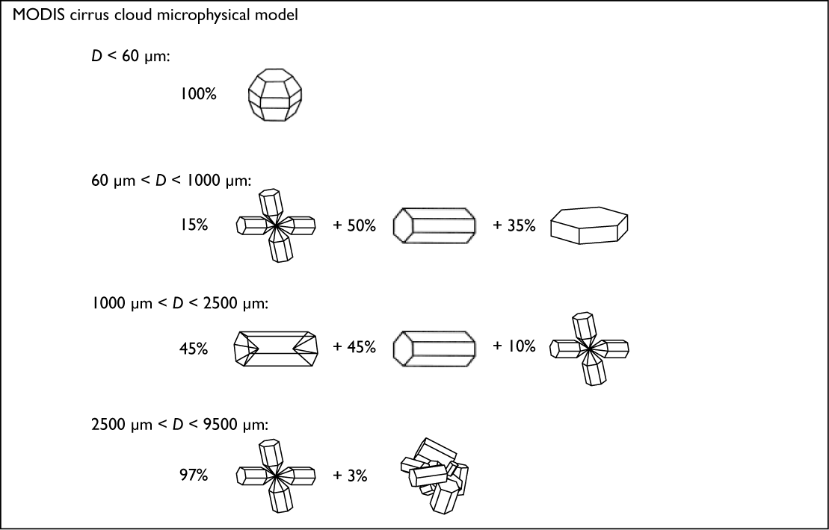
Ice Crystal Habit Distributions used in Collection 5 Light Scattering Calculations
Scattering Calculations made by Ping Yang, et al., TX A&M Model distributions by Baum, Heymsfield, et al. (2005)

Slide 9
Monthly Mean Ice Cloud Optical Thickness & Retrieval Fraction
April 2005
Aqua C5 (QA mean)
Notes:
ITCZ, southern oceans, convection in Southern Africa, East cost of US, elsewhere
Cloud_Optical_Thickness_Ice_QA_Mean_Mean

Slide 10
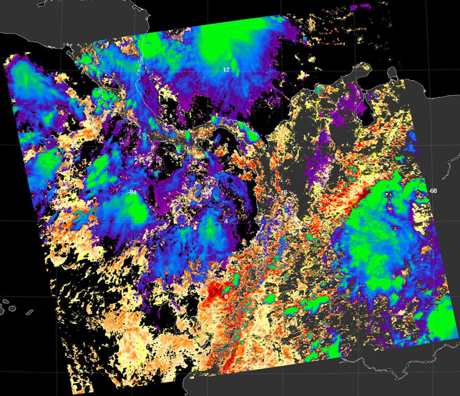
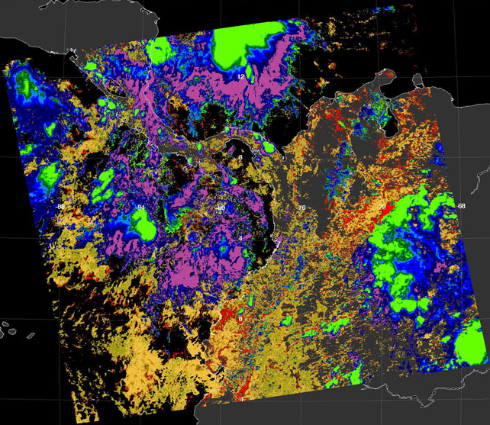
MODIS Aqua Uncertainty Example IWP, LWP, and Baseline Uncertainty Estimate
WP (gm⁻²)
ΔWP/WP (%)
Cloud_Water_Path
Cloud_Water_Path_Uncertainty
10
10²
10³
10
10²
10³
0
25
50
0
25
50
ice
water
ice
water
ice
water
Error sources: calibration/forward model,
surface albedo, atmospheric correction
Notes:
* Let’s look at some high resolution granule examples, that’s where you can really appreciate MODIS
Data granule centered over Central America
[explain dual color bar ]

Slide 11
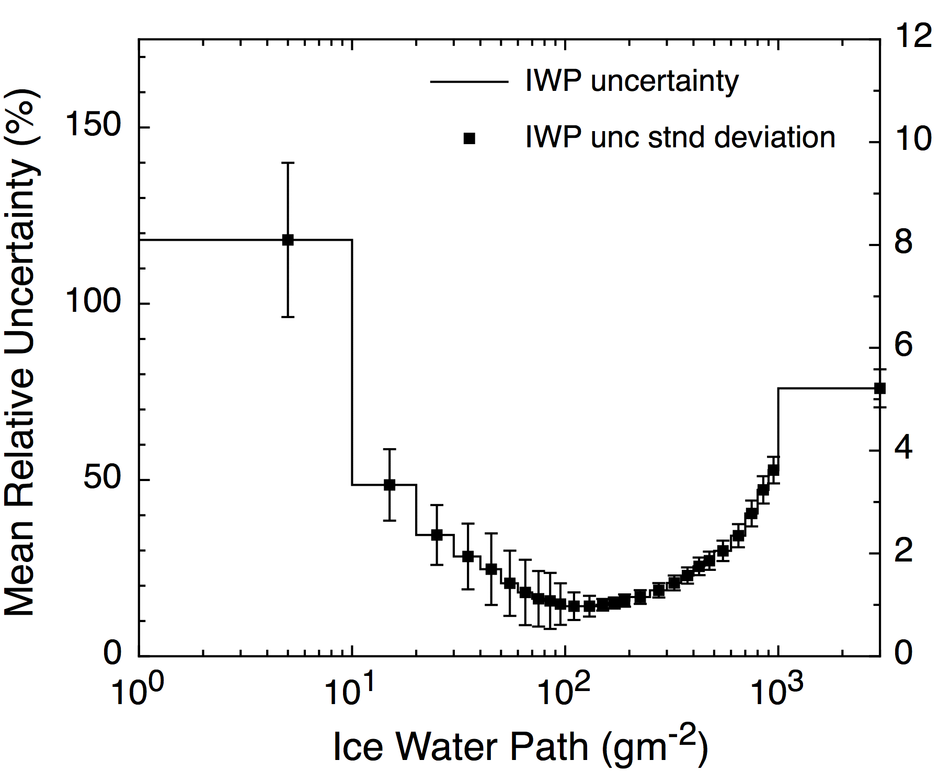
MODIS Aqua Uncertainty Example, cont. Uncertainty vs. IWP: Ocean Pixels Only
Notes:
Typical for retrievals, substitute x axis for what ever retrieved variable you like: you have a “sweet spot” and outside of that region of skill, things go to hell quickly
Bin rel unc by IWP
Min mean unc ~14% at just 100-200 g/m2

Slide 12
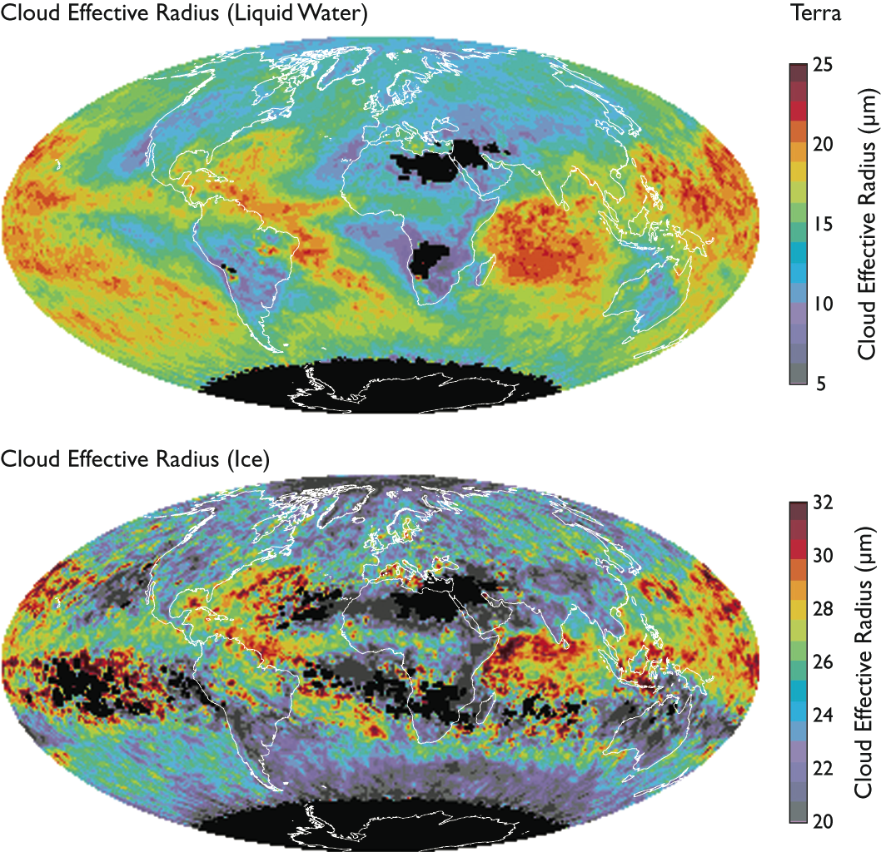
Monthly Mean Cloud Effective Radius Terra, QA Mean, July 2006
Liquid water clouds
Larger droplets in SH than NH
Larger droplets over ocean than land (less condensation nuclei)
Ice clouds
Larger in tropics than high latitudes
Small ice crystals at top of deep convection
Notes:
routine production of global re is NEW thanks to MODIS

Slide 13
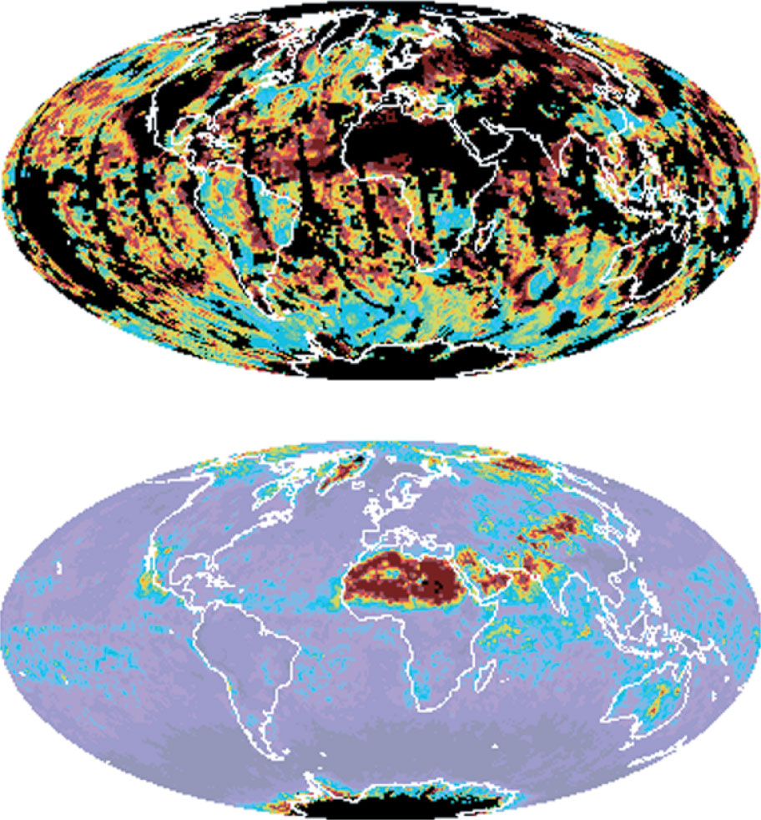
Uncertainty in Mean r_{e}: Daily & Monthly Example liquid water clouds, MODIS Aqua C5
Aqua: Daily
1 April 2005
Assumption:
pixel-level error sources correlated
Assumption:
daily errors uncorrelated (optimistic)
Aqua: Monthly
April 2005
Notes:
Water clouds only
Daily: unc can range into the high teens and greater
Monthly: high over deserts because there are few retrievals – notice on April 1 there were none

Slide 14
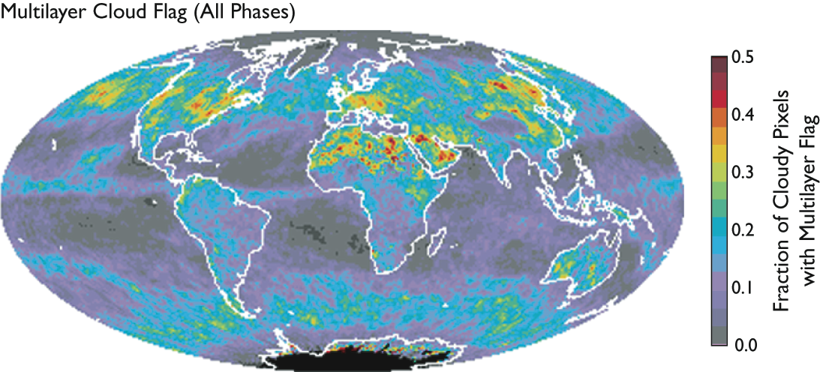
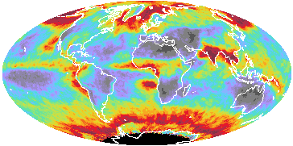
MODIS Level-3 C5 Multilayer Cloud Flag, August 2006 Fraction of retrieved cloudy pixels (all phases) where the flag is set
Aqua
Cloud Fraction (combined)
Terra
1.0
0.5
Notes:
ML algorithm is designed to flag cases where effective radius retrievals are affected by lower clouds, especially those of different phases.

Slide 15
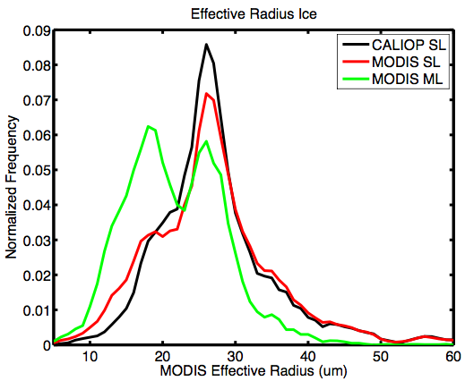
Impact on MODIS Ice Cloud Effective Radius Retrievals ±55° latitude, land & ocean, 4 days in Aug 2006 (Holz et al.)
MODIS Single Layer
distribution removes mode associated with water phase
(CALIOP SL => >1km thick and T_{mean}<-20)
Notes:
ML flag has some skill

Slide 16
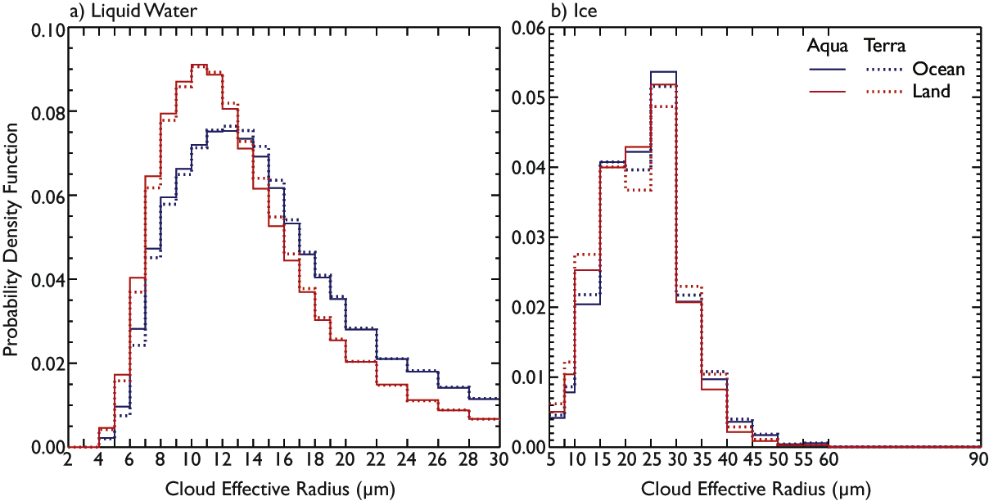
Level-3 Probability Distributions of Cloud Effective Radius July 2006
Mode r_{e} ~ 10-11 µm
Mode r_{e} ~ 12-13 µm
Mode r_{e} ~ 25-30 µm
Notes:
Global re: solid lines = Aqua; dashed = Terra; blue = ocean, red = land
Significantly smaller re over land
Lesson here: means don’t necessarily mean much, generally skewed distributions sometimes the mode (most likely value) is more informative

Slide 17
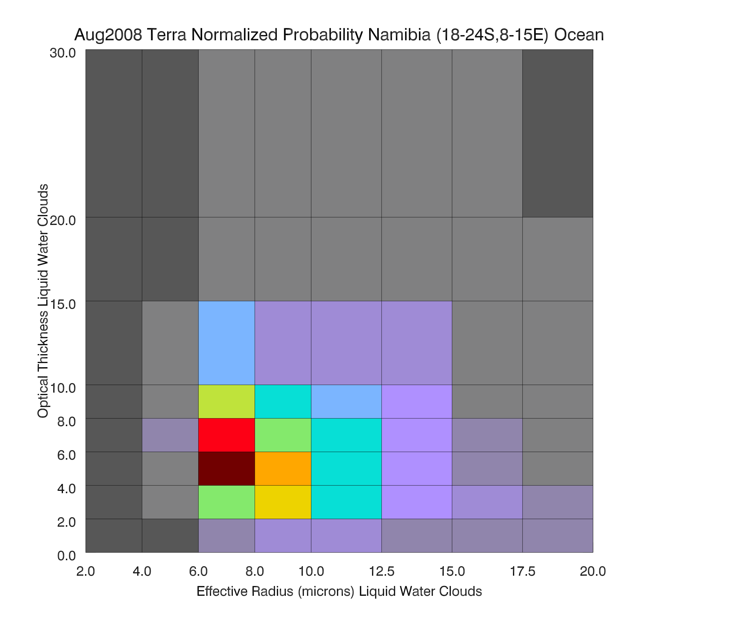
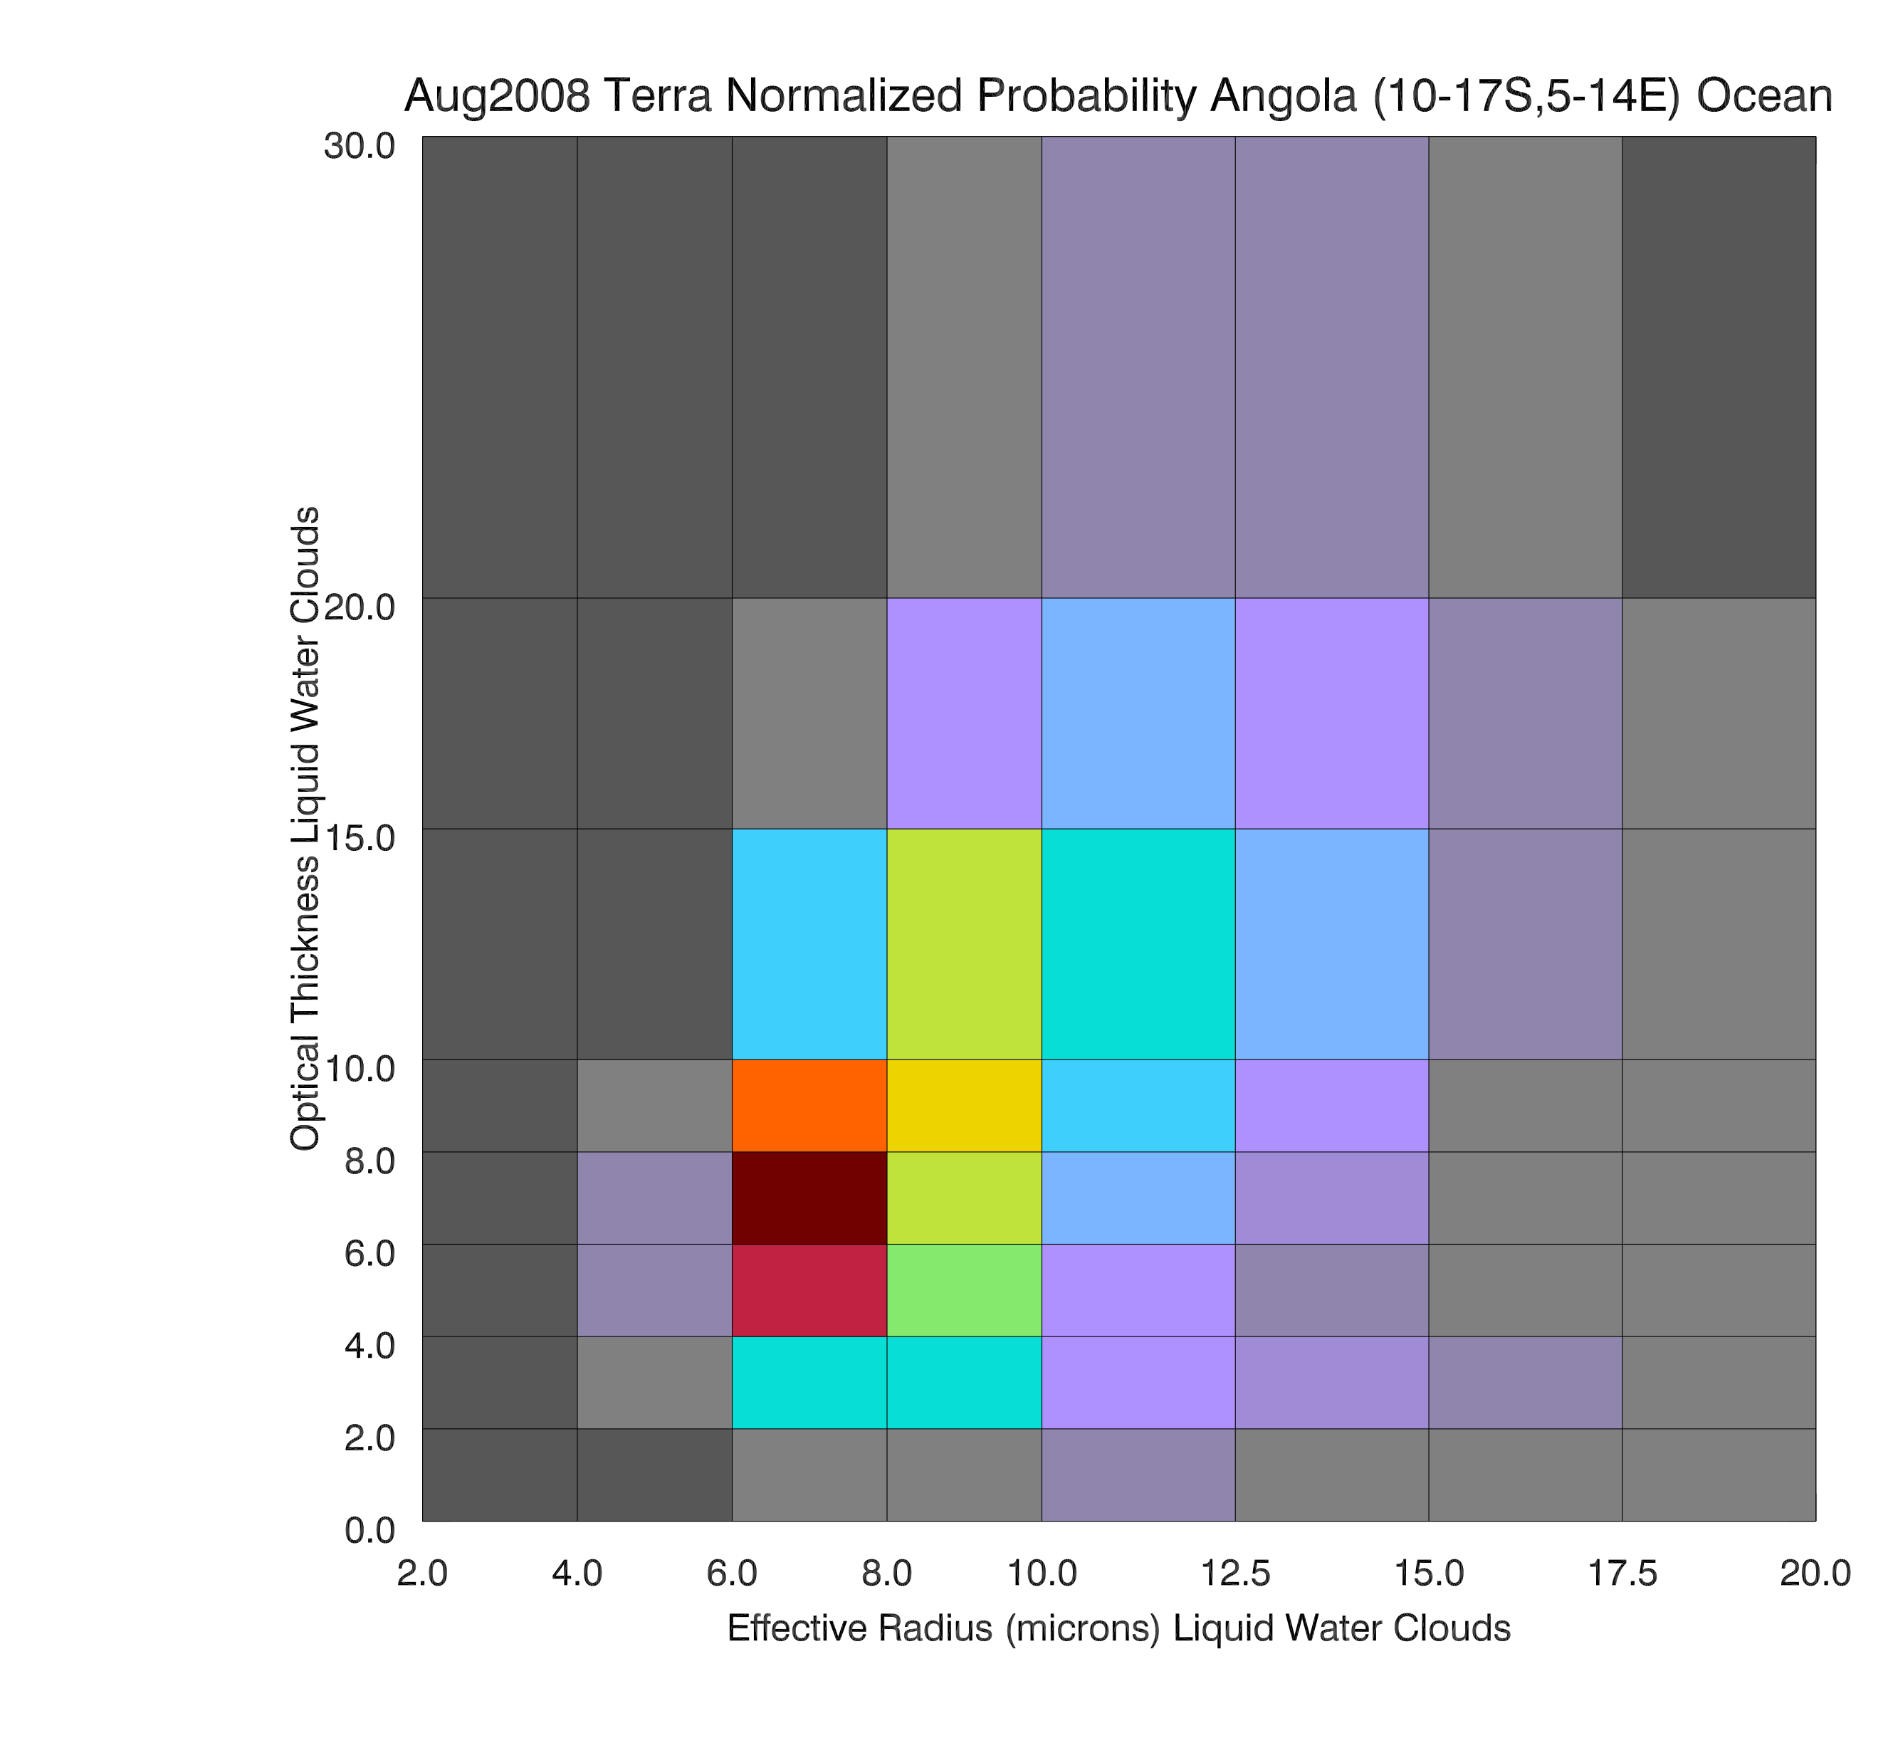
MODIS Optical Thickness vs Effective Radius 2D Histograms Marine Stratocumulus (Sc) Water Clouds, August 2007
Namibian Sc region
Angolan Sc region
bin probability (linear)
Notes:
2D distribution allow for the study of correlations, and we have a number of 2D cloud histograms in the L3 product

Slide 18
Summary and Thoughts
Progress in solar-reflectance cloud retrievals linked to progress in instrumentation (calibration and stability) and computational capability, as well as algorithms.
Some cloud retrieval quantities considered basic and fundamental are ill-defined. “Truth” is in the eye of the user.
Cloudy or clear (depends on the part of the spectrum and application)? Cloud-top height (radar vs. lidar vs. IR vs. polarization)? Cloud phase and effective particle size (local quantities, not vertically integrated)?
All retrievals (w/out exception) have issues with portions of the retrieval pdf space.
Simple statistics can be biased due to missing and/or error-prone portions of the pdf. Comparing means instead of pdfs between algorithms should be undertaken with great caution!
With some exceptions, individual pixel-level accuracies are not as relevant as uncertainties in the spatially and temporally aggregated statistics – but difficult to quantify.
Depends on the application, e.g., physical process studies, climatologies, radiation budget, model climate and forecast validation, data assimilation, etc
Notes:
i.e., certainly Instrument-driven to a large part
I don’t know what “truth” is, but I know it depends on the user. Truth … maybe not the beholder, but certainly the user

Slide 19
Summary and Thoughts (2)
Improving insight into many issues
Cloud detection: missing thin cirrus and false detection (aerosol, glint)
Thermodynamic phase of supercooled clouds
Spectral surface albedo (boundary condition for retrievals)
Applicability of 1D models (pixel level and aggregation affects): Vertical structure and multilayer cloud detection (e.g., cirrus over lower cloud), sub-pixel variability, partially cloudy pixels
Quantitative pixel-level and aggregation uncertainty estimates.
Synergy: A-Train active missions (CloudSat/CALIPSO) allow for some validation of optical properties, and assessment of vertical cloud structure and phase information (lidar).
MODIS algorithm provides legacy for SEVIRI, ABI/GOES-R, VIIRS, etc.

Slide 20
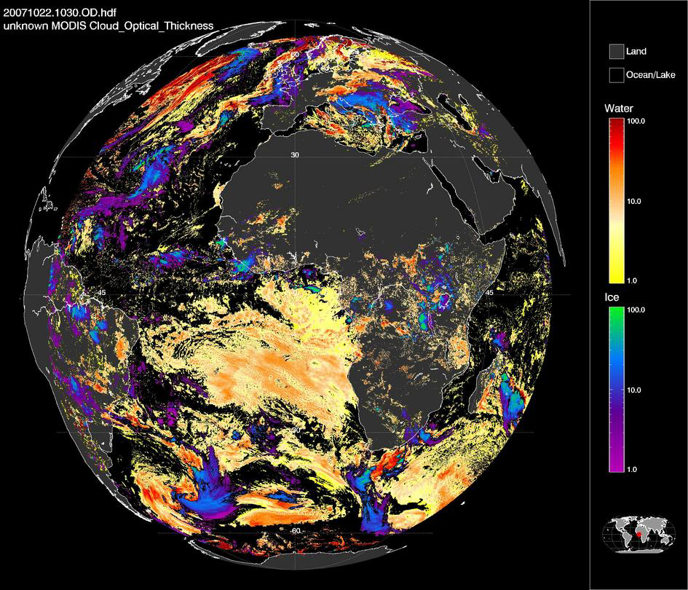
SEVIRI Cloud Retrieval Example – Optical Thickness 22 October 2007, 1030 UTC

